Slide 1

KGiSL INSTITUTE OF TECHNOLOGY
COIMBATORE
DEPARTMENT OF computer science & engineering
Project review # 01
AI-ENABLED NUTRITIONAL FITNESS ANALYSER
(DISABILITY WHEEL CHAIRPERSONS)
TEAM MEMBERS:
711720104101 VAISHNAVI V
711720104058 NIVETHA P K
711720104303 PRIYADHARSHINI P
711720104093 SUBHASH R
Under the guidance of :
Ms. JANANI R, AP/CSE

Slide 2

Abstract
To develop an AI-powered nutrition fitness analyzer for disabled Handicapped people revolutionizing dietary tracking and personalizing nutritional insights to optimize health and fitness goals effectively.
It uses machine learning and ultrasonic sensor and NLP, which tracks their dietary intake by recognizing through their voice-speech, text and image recognition to track progress towards fitness goals.
By combining AI and nutrition science, the tool aims to revolutionize dietary tracking and optimize health and fitness effectively.

Slide 3
EXISTING SYSTEM
Existing Nutri Fitness Analyzer systems have only calculated weight, and calories for normal being people. It consists of a scanner and barcode, images procession of food, and gives us the data.
Typically It does not exist for Physically Handicapped people, Disabled persons in their day-to-day lives. They found it difficult to run a healthy lifestyle.
There are only languages in English and Hindi, no other languages exist, in other apps, there is no touch sensor and voice input for disabled persons.
DRAWBACKS OF EXISTING SYSTEM
Accessibility: Many existing AI-enabled nutri-fitness analyzers may not be designed with wheelchair users in mind, leading to accessibility issues.
User Interface Design: The user interface may not be optimized for wheelchair users, making it difficult for them to interact with the system effectively.
Physical Constraints: Wheelchair users may have limited physical ability to use certain features of the system, such as manual input or interaction with hardware components.

Slide 4
Literature survey
S.no | Published Date | Paper Title | Author | Methodology
1 | 2024 | Ethical Considerations and Privacy Concerns in AI-Powered Nutrition and Fitness Analyzers for handicapped persons | Anna Garcia, Robert Patel | Exploration of ethical and privacy issues in AI-based health analyzers. Discusses regulatory frameworks and proposes guidelines.
2 | 2023 | Clinical Applications of AI-Enabled Nutrition and Fitness Interventions in Chronic Disease Management | Michael Brown, Sarah Adams | Systematic review of RCTs and observational studies on AI-driven interventions for chronic disease management.
3 | 2022 | AI-Driven Fitness Tracking and Monitoring: A Review of Wearable Technologies | Emily Johnson, David Lee | Review of wearable tech integration with machine learning for activity recognition and performance evaluation.
Drawbacks
Limited enforcement mechanisms and vulnerabilities in data security
Limited generalizability and challenges with long-term adherence.
Reliance on proprietary algorithms and variable accuracy across activities and users.

Slide 5
Literature survey
S.no | Published Date | Paper Title | Author | Methodology
4 | 2021 | Personalized Dietary Analysis and Recommendations Using Machine Learning | John Smith, Jane Doe | Deep learning approach with CNNs for food image classification and NLP for text analysis.
5 | 2020 | Addressing Bias in AI-Based Nutritional Analysis: A Case Study Approach | Laura Chen, Kevin Nguyen | Conducts case studies to identify and mitigate biases in AI algorithms used for nutritional analysis.
6 | 2019 | Exploring User Engagement in AI-Enabled Nutrition and Fitness Apps | Maria Rodriguez, Daniel Kim | Investigates user engagement strategies in AI-powered nutrition and fitness apps through user surveys and behavior analysis
Drawbacks
Limited accuracy due to image quality variations and lack of consideration for cultural dietary differences.
Challenges in identifying and quantifying biases, particularly in complex, real-world datasets
Limited generalizability due to sample biases and challenges in accurately measuring user engagement metrics

Slide 6
PROPOSED SYSTEM
Implement voice recognition technology to allow users to input data and interact with the system using voice commands. This feature would enable wheelchair users to provide dietary information, set fitness goals, and navigate the interface hands-free.
Partner with healthcare professionals and accessibility experts to ensure that the system meets the specific needs of wheelchair users and aligns with best practices in disability-inclusive design.
Regularly update the system based on user feedback, emerging technologies, and advancements in AI and accessibility standards to ensure ongoing relevance and effectiveness.
ADVANTAGES OF PROPOSED SYSTEM
Accessibility: By optimizing the user interface and incorporating alternative input methods such as voice recognition and simplified controls, the system becomes accessible to wheelchair users with varying levels of mobility and dexterity.
Personalization: The system utilizes AI technology to provide personalized nutrition and fitness recommendations based on individual needs, preferences, and mobility limitations.
Collaboration with healthcare professionals: It ensures that the system aligns with best practices in disability-inclusive design and meets the specific needs of wheelchair users.

Slide 7
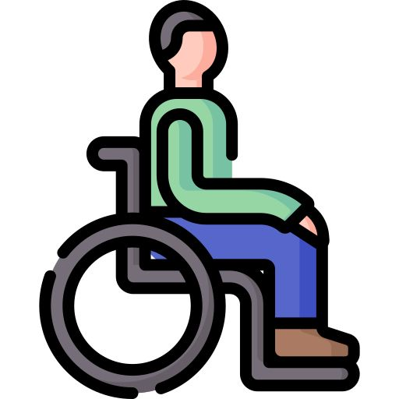


Architectural Diagram
User Data Collection
Preprocess
Algorithm
Implementation
Model
Creation
Calorie tracker
Android Application
Food recommendations
Workout videos
Feedback to improve user’s health
PROJECT–FIRST REVIEW Department of CSE, KGiSL Institute of Technology, Coimbatore

Slide 8
Modules split up
Module 1 : UI and Accessibility Module
Module 2 : AI-powered video recommendations
Module 3 : Food image recognition for calorie calculation
Module 4 : Feedback mechanism

Slide 9

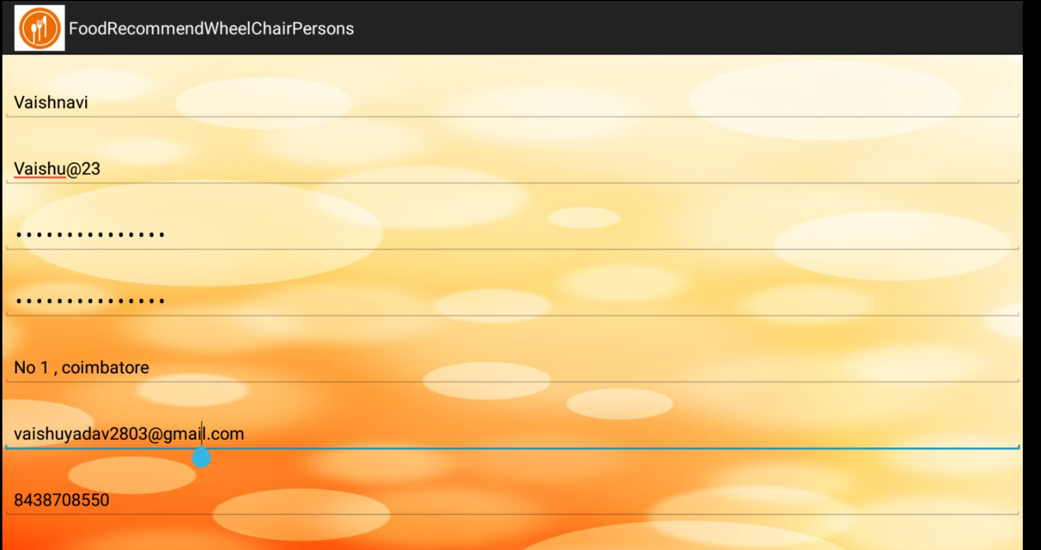
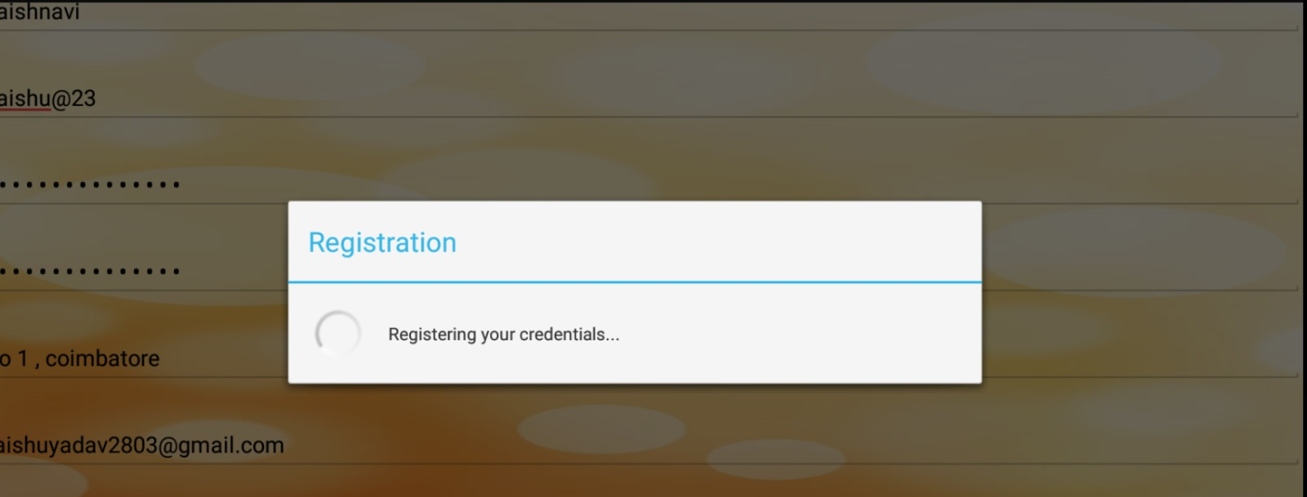
Module 1- UI and Accessibility Module

Slide 10
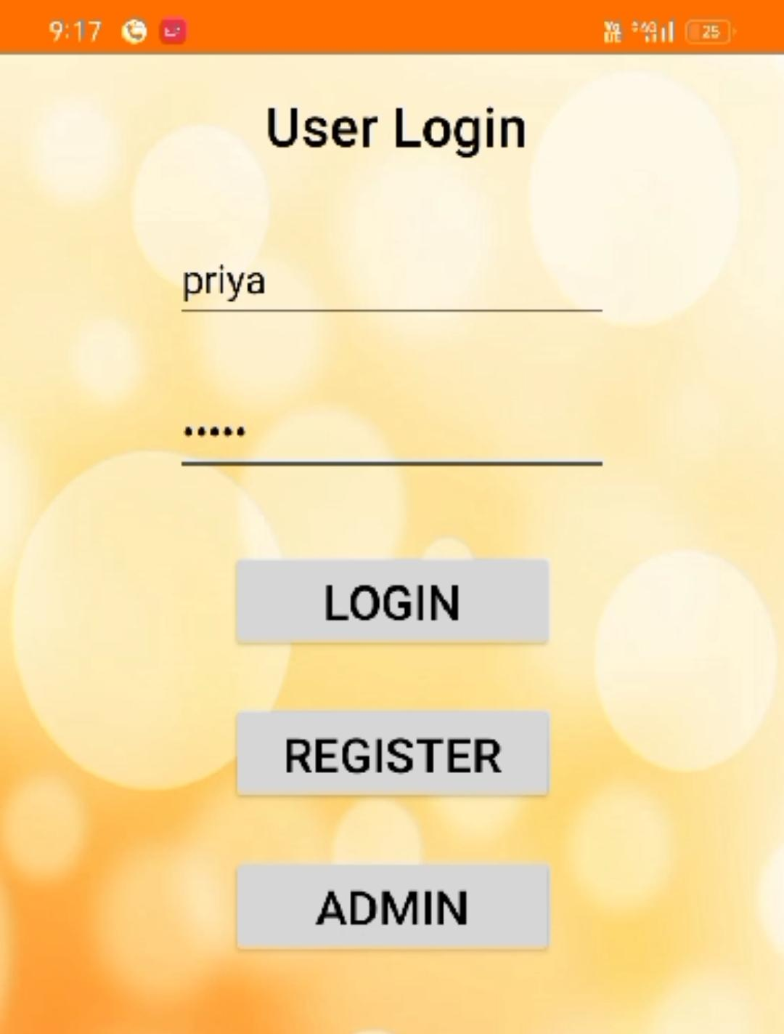
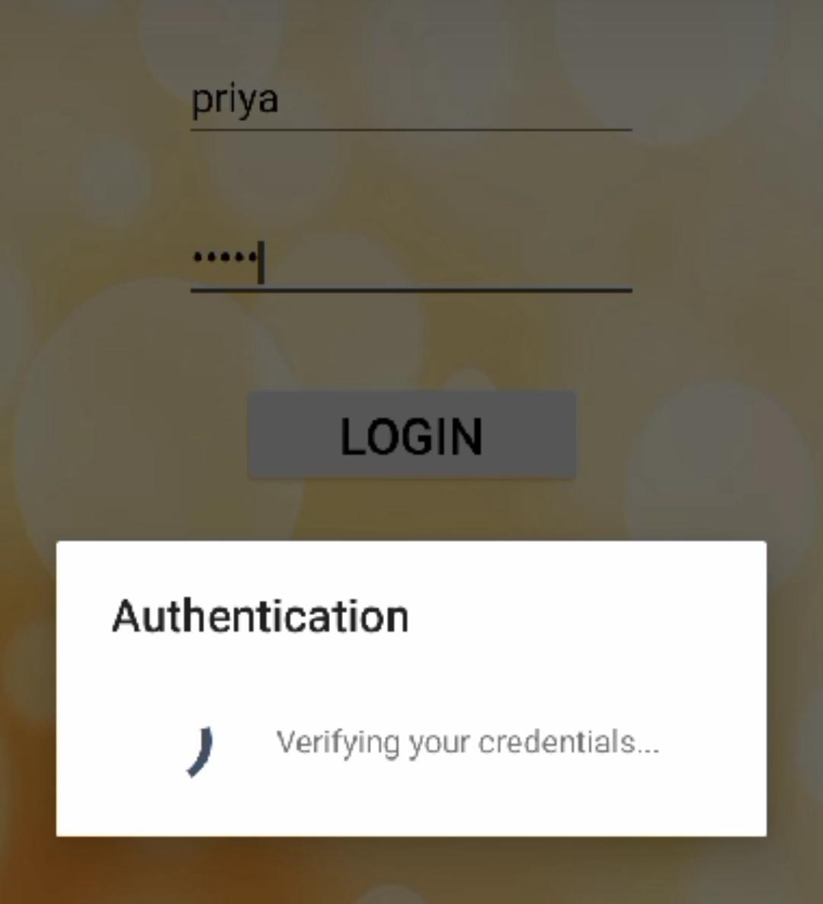
Login Page

Slide 11
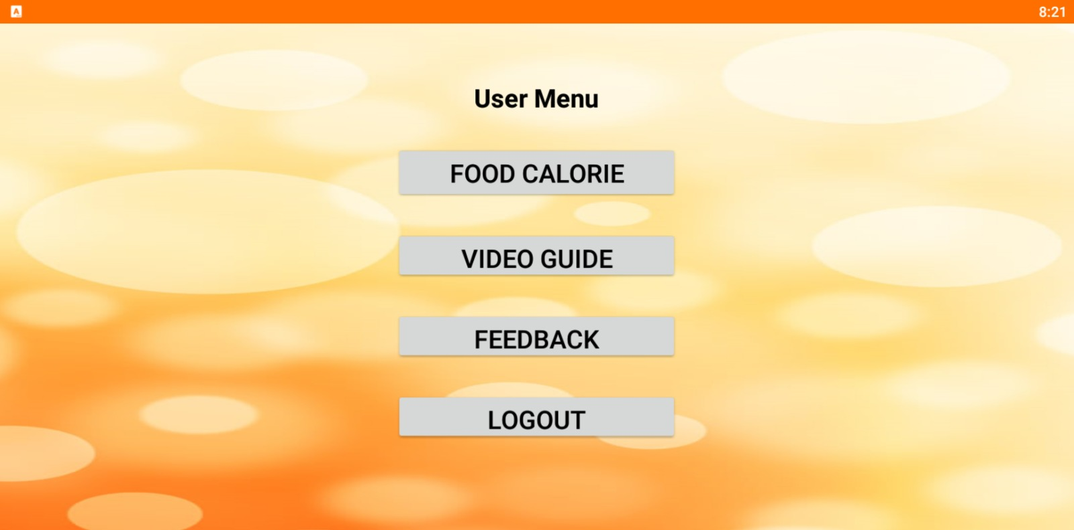
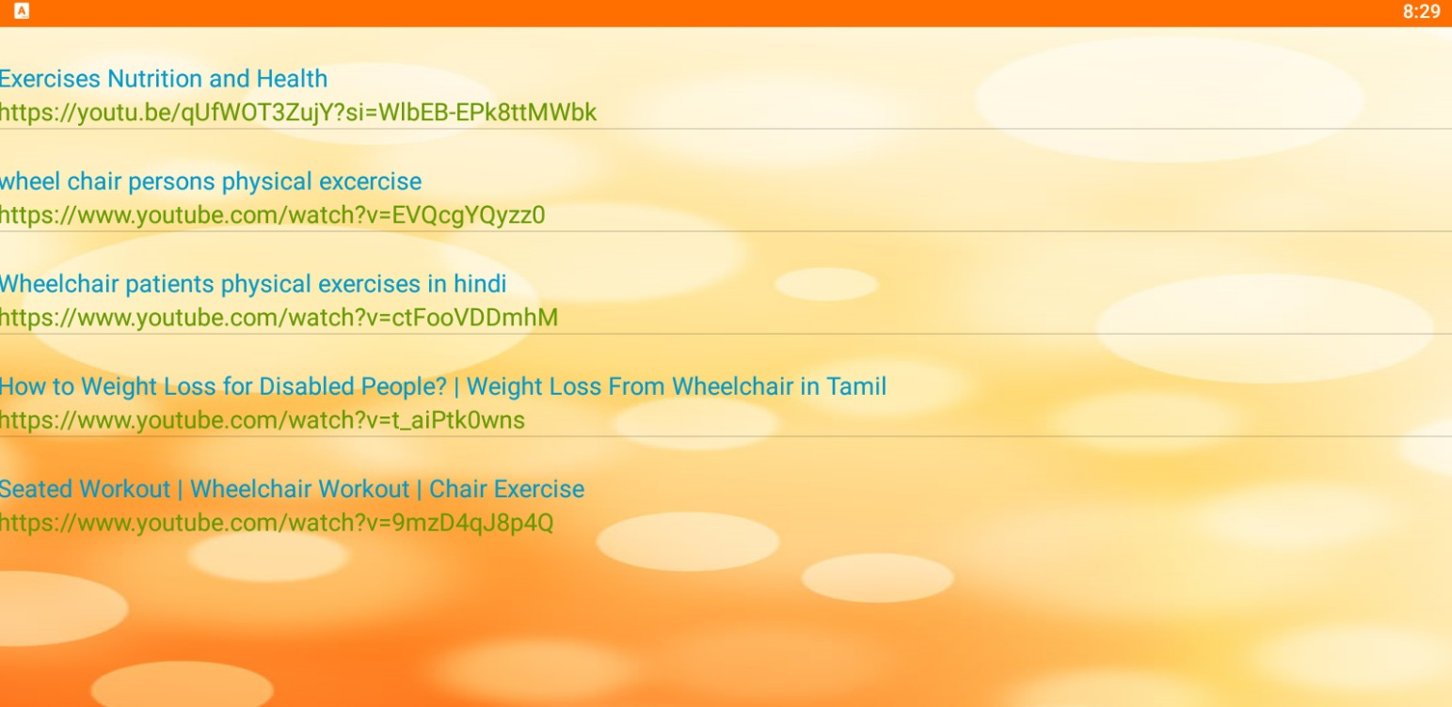

Module 2 - AI-powered video recommendations

Slide 12
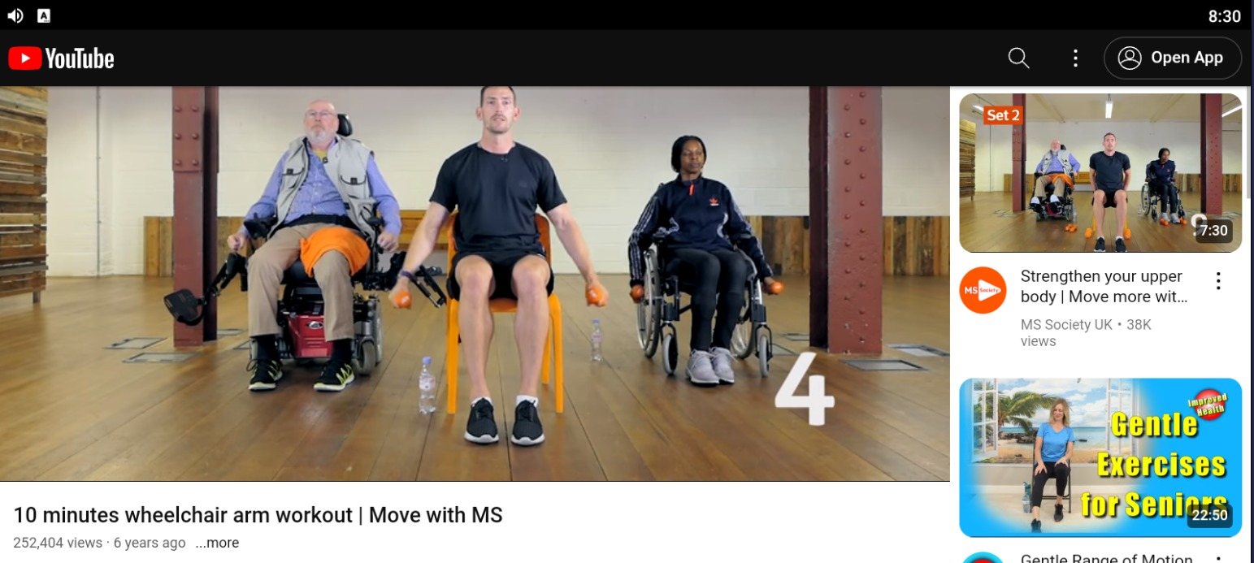
Accessing videos

Slide 13
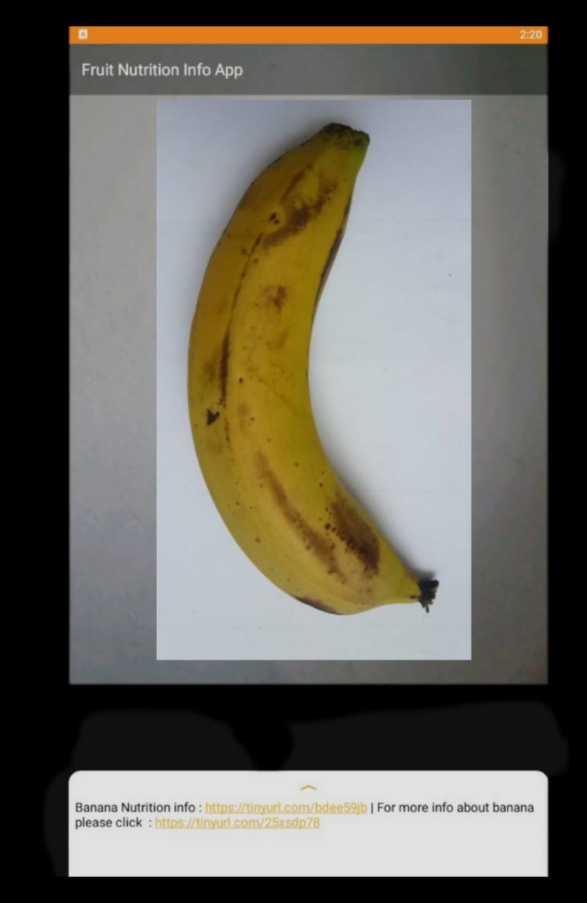
Module -3 Food image recognition for calorie calculation

Slide 14
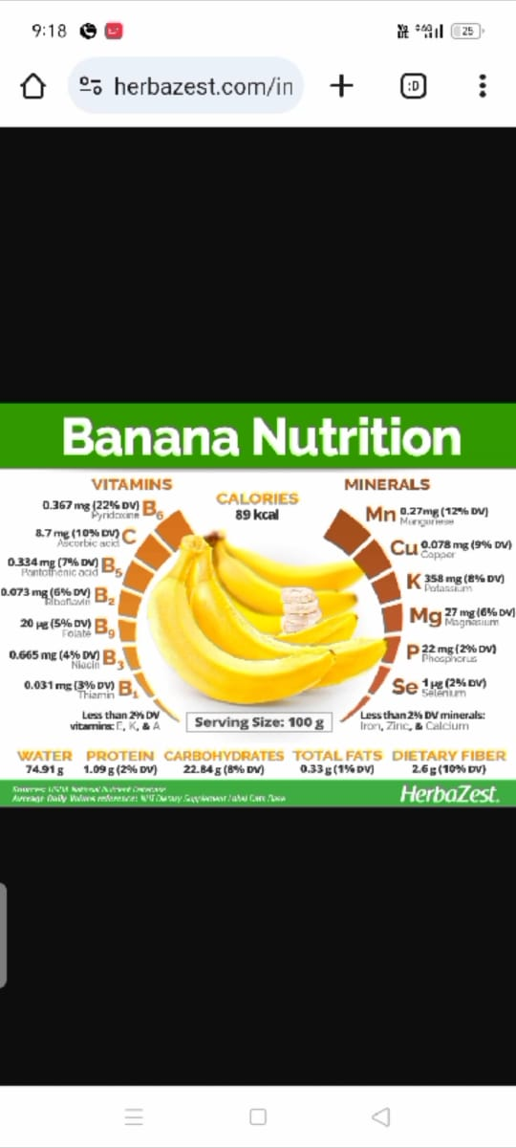
Displaying calorie information

Slide 15
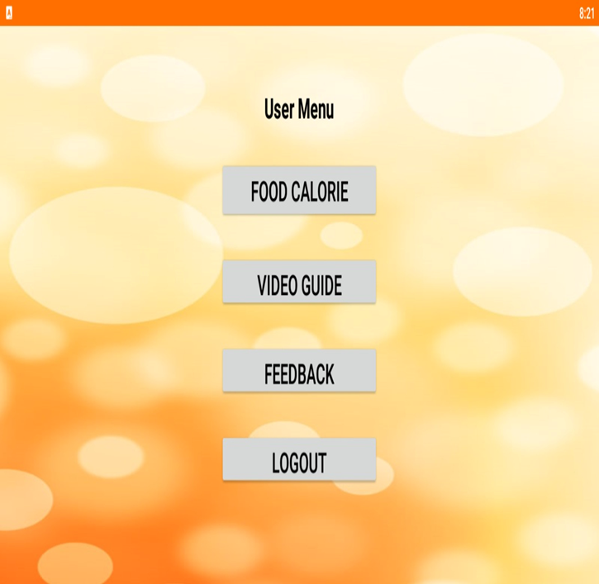
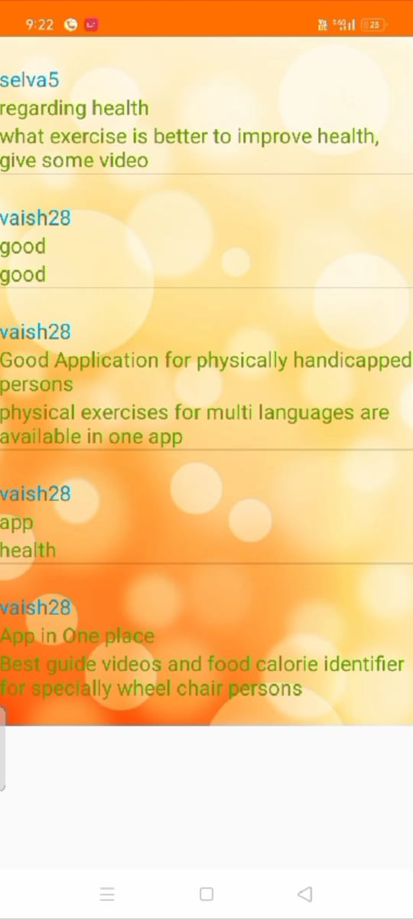
Module -4 Feedback mechanism

Slide 16
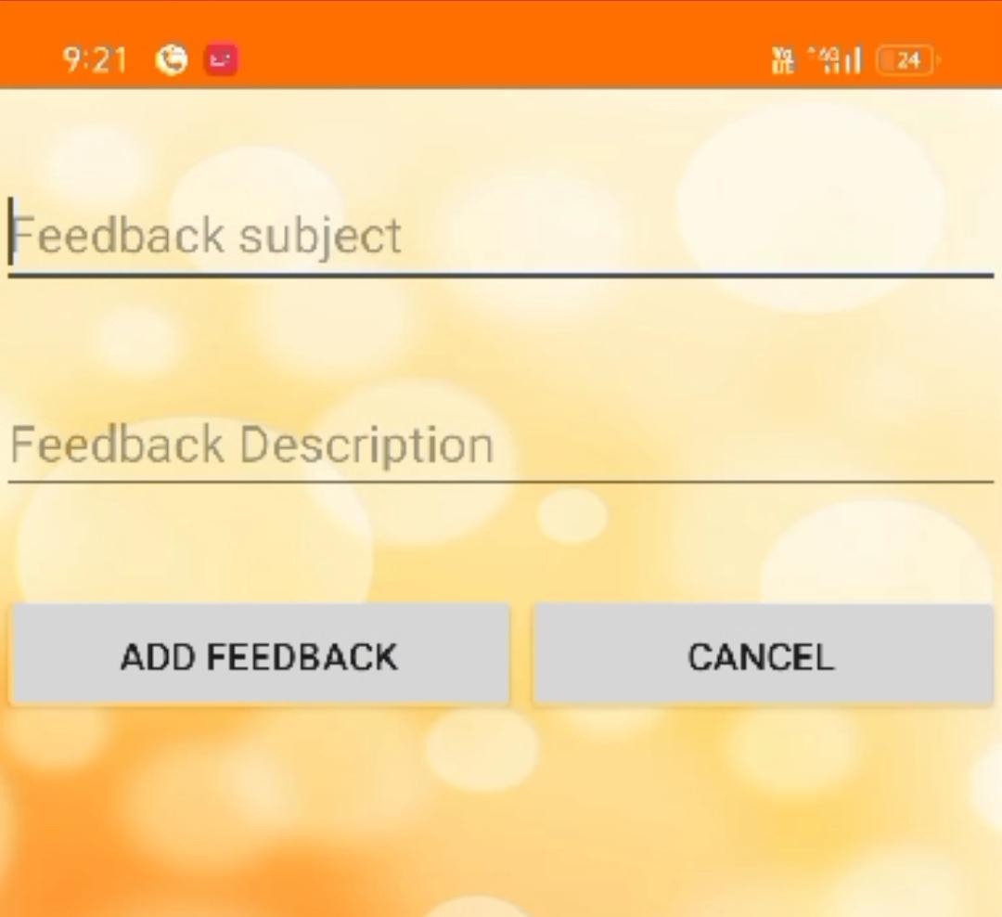
User feedback

Slide 17
EXPECTED OUTCOME
Improved Health and Well-being.
Enhanced Accessibility and Inclusivity.
Empowerment and Self-management.
Support for Healthcare Professionals.
Data-driven Insights and Research.

Slide 18
REFERENCE
Johnson, E., Kim, S. (2024). "Advancements in AI for Personalized Nutrition and Fitness Tracking." International Journal of Artificial Intelligence in Health and Fitness, 8(2), 112-129.
Patel, R., Garcia, A. (2023). "Machine Learning Approaches for Nutritional Analysis and Dietary Recommendation Systems." Journal of Health Informatics and Technology, 15(4), 245-260.
Chen, L., Nguyen, K. (2022). "AI-Enabled Fitness Apps: Challenges and Opportunities." Journal of Digital Health and Wellness, 3(1), 45-58.
Rodriguez, M., Lee, D. (2021). "User Engagement Strategies in AI-Powered Nutrition and Fitness Apps." Proceedings of the International Conference on Health Informatics, 78-85.
Chen, L., Wang, Y., & Zhang, X. (2020). "SmartFit: A Machine Learning-Based Nutritional Fitness Analyzer for Personalized Diet and Exercise Recommendations." Journal of Health Informatics Research, 8(2), 110-125.
Smith, J. (2019). Towards Inclusive Nutri-Fitness Analysis: A Review of Accessibility Considerations for Wheelchair Users.

Slide 19
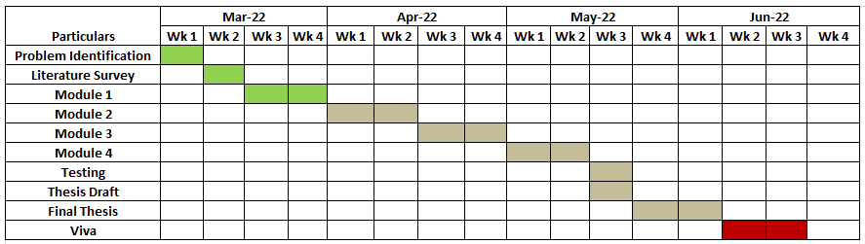
TIMELINE

Slide 20
THANK YOU

